Slide 1
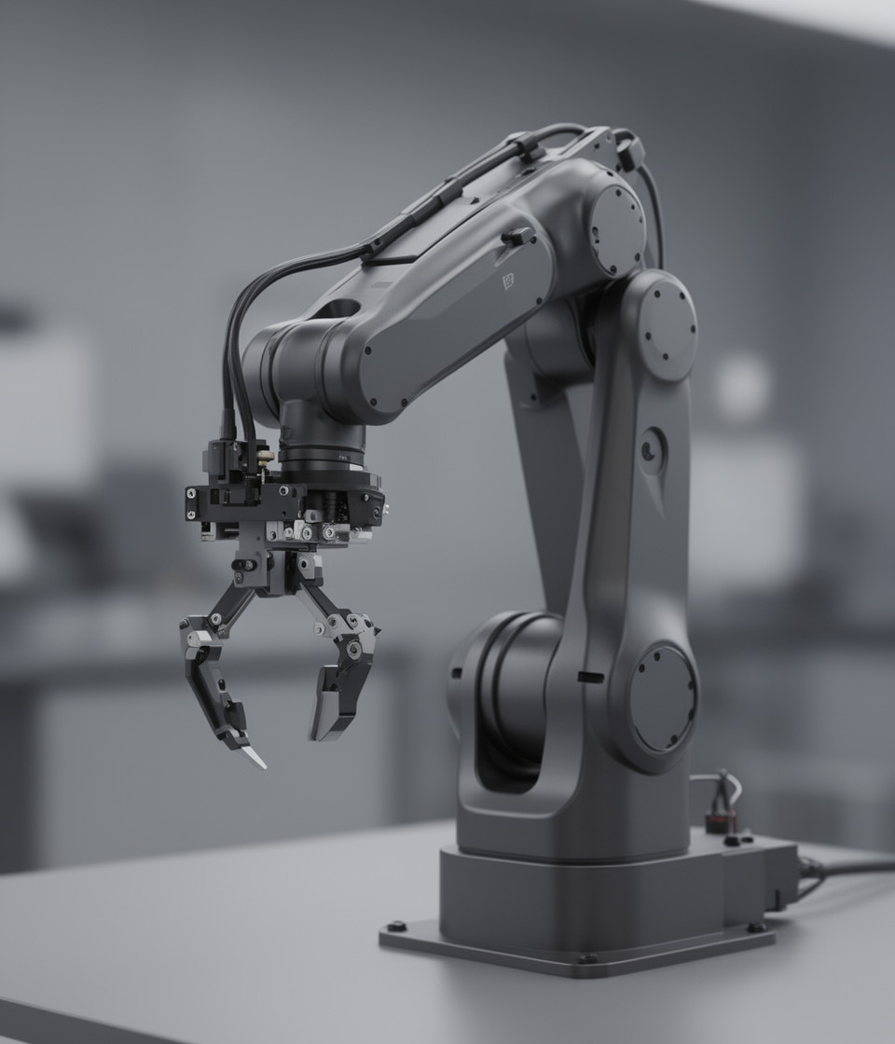
Progress Report
Weekly Project Update Overview

Slide 2
Weeks 1-3 Sensing Architecture
Determine what sensing architecture to use as well as what vision and measurement to use on the robot.
Project Development Timeline
Weeks 4–6 Mechanical & Actuation
Structural design of the 4-DOF robotic arm, choice of actuators, and the pneumatic gripper.
Weeks 7-9 Control & Programming
Build the control system with ROS2, STM32 motor controller and motion planning.
Weeks 10–12 Integrate all subsystems
Connect all subsystems and test the system on the smart pick-and-place operation.

Slide 3
Weekly Progress Goals
DONE
ONGOING
01
02
03
ROBOTIC ARM DESIGN FINALIZATION
PNEUMATIC GRIPPER SYSTEM
MECHANICAL & CONTROL VALIDATION
The full CAD model of the robotic arm was finalized, including joint geometry, link dimensions, and end-effector integration. The design is now ready for simulation and control integration.
A vacuum-based gripper was integrated into the end-effector. Suction force calculations were performed based on object weight, and the required pressure from the compressor was determined. Component selection is nearing completion.
Joint torque requirements were calculated based on arm geometry and payload. The full system model was converted into URDF and integrated into ROS2 MoveIt2 for motion planning and simulation using the actual robot geometry.

Slide 4
Weekly Timeline
Robotic arm CAD model was finalized, including joint geometry, link dimensions, and end-effector integration.
1
Vacuum gripper was integrated into the design and suction force calculations were performed to determine required compressor pressure.
2
Joint torque requirements were calculated based on arm geometry and payload, supporting motor sizing and actuator selection.
3
Full system model was converted into URDF and integrated into ROS2 MoveIt2 for motion planning and simulation with real geometry.
4

Slide 5
Goal # 1
PROGRESS CHECK
Robotic arm CAD model was finalized, including joint geometry and link dimensions.
Joint torque requirements were calculated based on arm configuration and payload.
Vacuum gripper was integrated and suction force/pressure requirements were determined
Mechanical & Actuation Validation
Completed
BLOCKERS
Verification of vacuum gripper performance under real operating conditions.
Can’t test vacuum gripper in gazebo
ACTION ITEMS
Validate gripper performance with physical testing or simulation.

Slide 6
Goal # 2
PROGRESS CHECK
Vacuum gripper was integrated into the robotic arm end-effector design.
Suction force calculations were performed based on object weight (ball/compass).
Required pressure range from the compressor was determined for reliable gripping.
Pneumatic Gripper System
In progress
BLOCKERS
Final selection of compressor and vacuum components pending availability and system constraints.
Physical validation of suction performance has not yet been conducted
ACTION ITEMS
Finalize vacuum pump/compressor selection based on required pressure and flow rate.

Slide 7
Goal # 3
PROGRESS CHECK
Developed an initial ball tracking algorithm to detect and follow the target object, enabling autonomous positioning of the robotic arm.
This tracking approach supports full 4-DOF operation by guiding the end-effector toward the object location.
Vision & Control system
In progress
BLOCKERS
Real-time performance and accuracy of object tracking not yet validated on hardware.
ACTION ITEMS
Complete ball tracking implementation and link it with ROS2 control.
Integrate vision feedback with MoveIt2 for autonomous motion execution.
Perform calibration and testing using the selected depth camera.

Slide 8
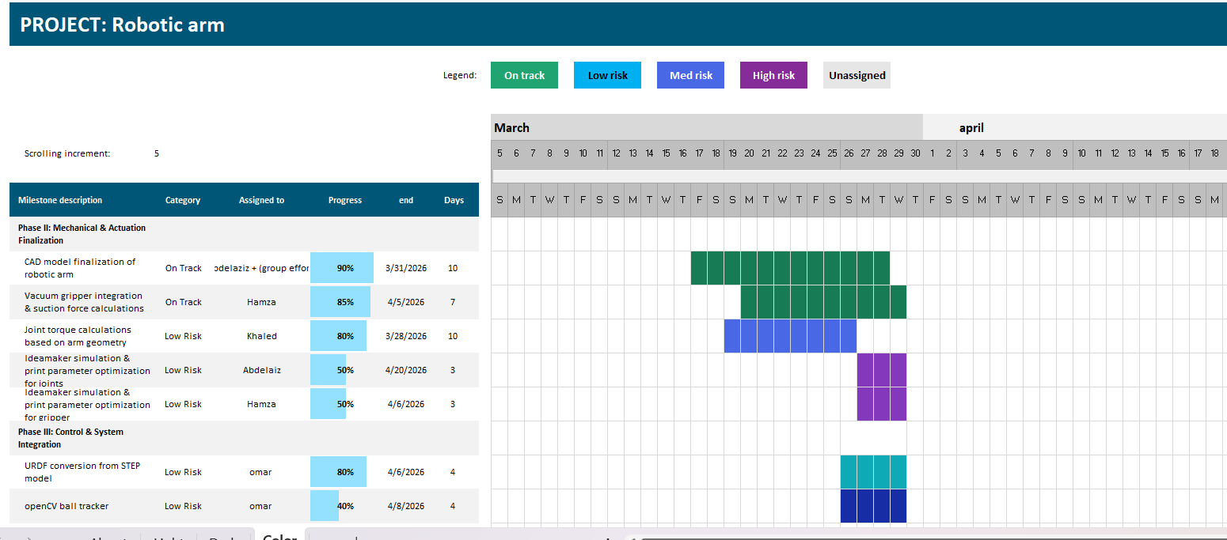
Project schedule (Gantt)

Slide 9
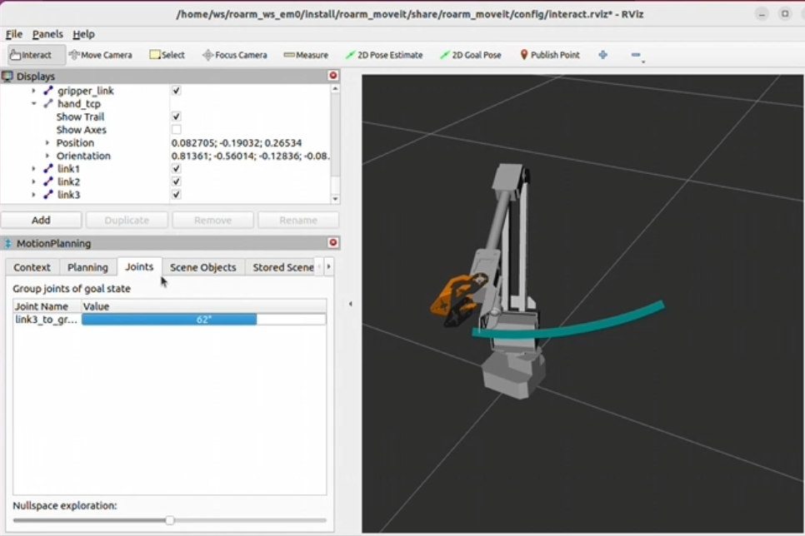
Omar’s progress
Accomplished (since last report)
Evidence (show, don’t tell)
Implemented final URDF of the model in gazebo and Rviz2 for moveit2 control based on final geometrical features
Made an OpenCV classifier that follows a red ball for autonomous vehicle for 2D tracking as of now
Time frame:
Weeks 1-3
Main role:
Software & Ros2
Next Week Plan
In Progress
Help Needed / Questions
Use a model for object detection and tracking of a red ball and connect a depth camera and see how it behaves
Implement ros2_control with the robotic arm to achieve full autonomy
Hardware specs confirmation
Motor driver compatibility
ROS2 integration issues

Slide 10
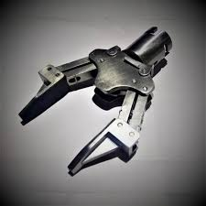
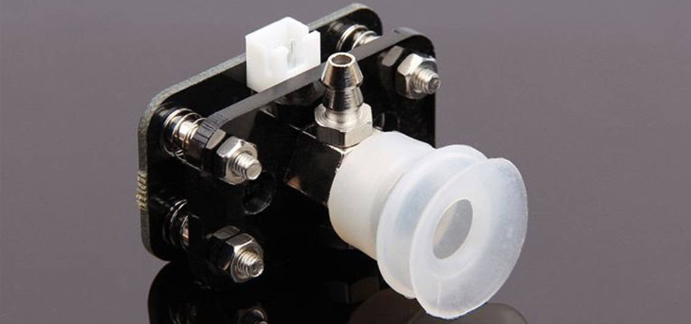
Hamza’s progress
Accomplished (since last report)
Evidence (show, don’t tell)
Carried out the first study regarding pneumatic gripper mechanisms that could be used in pick-and-place robotic arms.
Researched on various pneumatic actuation techniques such as single-acting and double-acting cylinders in gripping motion.
Examined important aspects of pneumatic component.
Time frame:
Weeks 1-3
Main role:
Gripper(pneumatic)
Next Week Plan
In Progress
Help Needed / Questions
compare the various types of pneumatic cylinders and gripper designs in order to come up with the best suited one to use in the robotic arm..
To determine the range of pressure and amount of air needed to be dependable in gripping.
The development of a simple gripper framework which can fit the robotic arm end-effector.
Confirm compressor pressure and specifications.
Instruction on how to set the solenoid valve to the microcontroller..
Verify compatibility with the robotic arm mounting interface.
Complete pneumatic cylinder and gripper.
Make a detailed list of pneumatic parts to be bought.
Begin CAD design of the gripper mechanism and mounting interface with the robotic arm.
Evaluate the integration of solenoid valve control with the microcontroller.

Slide 11
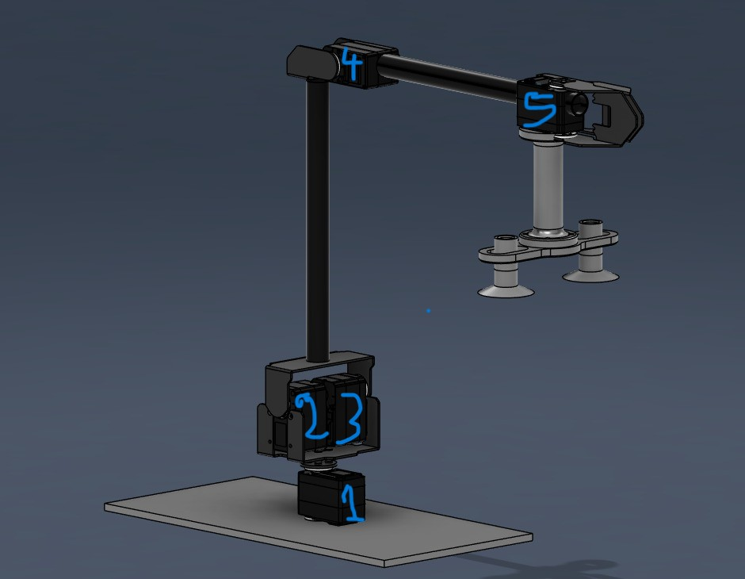
Accomplished (since last report)
Khaled's progress
Defined a 5-DOF actuator configuration, where each actuator controls motion in a different axis.
Combined Actuator 2 and 3 to increase force and improve the ability to lift heavier loads.
Selected a high-torque servo motor with encoder for accurate and reliable control.
Performed detailed torque calculations for each actuator based on arm dimensions and expected loads.
Evidence (show, don’t tell)
Time frame:
Week 4
Main role:
Actuator Selection, Design & Torque Calculation
Next Week Plan
In Progress
Help Needed / Questions
Finalize actuator specifications based on torque requirements
Select suitable motor drivers for the chosen actuators
Begin hardware integration planning
Calculating the required torque for each actuator.
Studying integration of actuators with Arduino and ROS2 control system
Confirmation of maximum payload weight for accurate calculations
Verification of safety factor assumptions

Slide 12
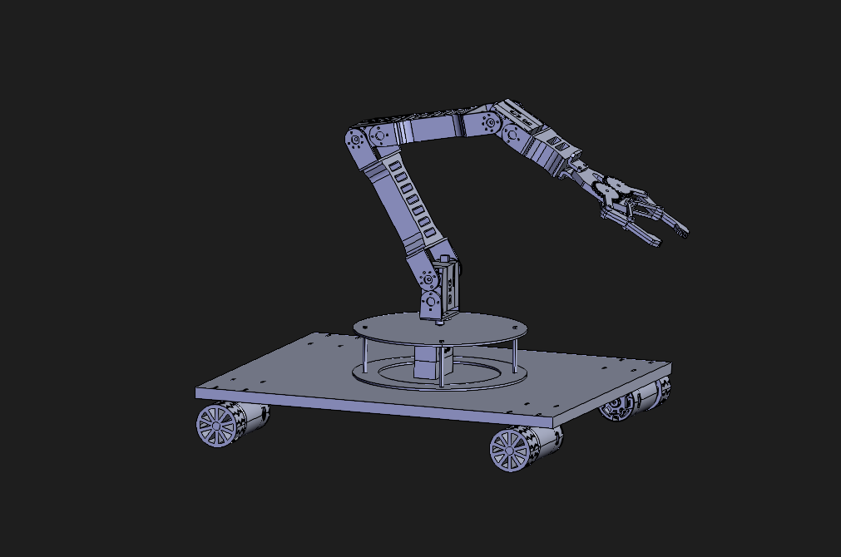
Abdelaziz’s progress
Accomplished (since last report)
Evidence (show, don’t tell)
Researched various designs of robotic arm and industrial arm.
Choose number of Degrees of Freedom (DOF) and joint movement.
Choosing a 6-DOF robotic arm concept.
Created the initial mechanical design (base, links, joints).
Researched the materials and dimensions to be used..
initial conceptual design. Design.
Time frame:
Weeks 1-3
Main role:
Mechanical structure
Next Week Plan
In Progress
Help Needed / Questions
Fully realistic model of the robotic arm CAD.
Complete the size and the connection lengths of the building.
Choose appropriate motors or actuator of each joint.
Determine the design of the mounting of the robotic arm on the mobile platform.
Begin basic loading tests or mechanical simulation of the design.
Optimizing the mechanical design of the arm links and joints.
Assessment of various joint mechanisms in order to move smoothly.
Completion of CAD assembly of complete robotic arm system.
Recommendations on the choice of appropriate motors/servos to be used at each joint.
Suggestions on material of light yet stiff robotic arm links.
Assurance of the best number of DOF required in the project.
Response to the present CAD plan of the arm design.

